Slide 1

Innopolis University
Control Theory (Linear Control)
Lecture 4
Stabilizing Control
Sergei Savin, PhD
Slides design by Marko Pezer & Artem Bakhanov

Slide 2
Topic of the Lecture
Stabilizing Control
Control Error
Proportional and Proportional-Derivative Control
Proportional-Integral-Derivative (PID)
Lyapunov Stability
Control Theory (Linear Control)
Slide 2

Slide 3

Stabilizing Control (1/3)
$$\dot{x}=f\left(x,u\right)$$
Given desired state $x^{∗}=const$,
find $u=u\left(t\right)$ such that solution $x=x(t)$ approaches $x^{∗}$
(from all initial conditions (IC) or a range of IC)
Control Theory (Linear Control)
Slide 3

Slide 4

Stabilizing Control (2/3: Example)
$$\dot{x}=7x+u$$
For the desired state $x^{∗}=0$,
if $u\left(t\right)=−8x(t)$ then $\dot{x}=−x$
and $x\left(t\right)=Ce^{−t}$ which approaches 0
Control Theory (Linear Control)
Slide 4

Slide 5

Stabilizing Control (3/3)
If $x^{∗}=0$
$$\dot{x}=Ax+Bu$$
$$u=−Kx$$
Find K such that $A−BK≺0$
Control Theory (Linear Control)
Slide 5

Slide 6
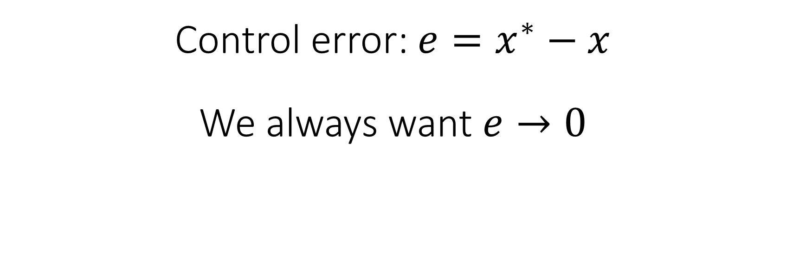
Control Error
Control error: $e=x^{∗}−x$
We always want $e→0$
Control Theory (Linear Control)
Slide 6

Slide 7

Control Error and Trajectory Tracking (1/2)
Assume there is such $x^{∗}=x^{∗}\left(t\right)$ that
$${\dot{x}}^{∗}=Ax^{∗}$$
Then: ${\dot{x}}^{∗}−\dot{x}=Ax^{∗}−Ax−Bu$
$$\dot{e}=Ae−Bu$$
If so, and if $u=Ke$
Find $K$ such that $A−BK≺0$
Control Theory (Linear Control)
Slide 7

Slide 8
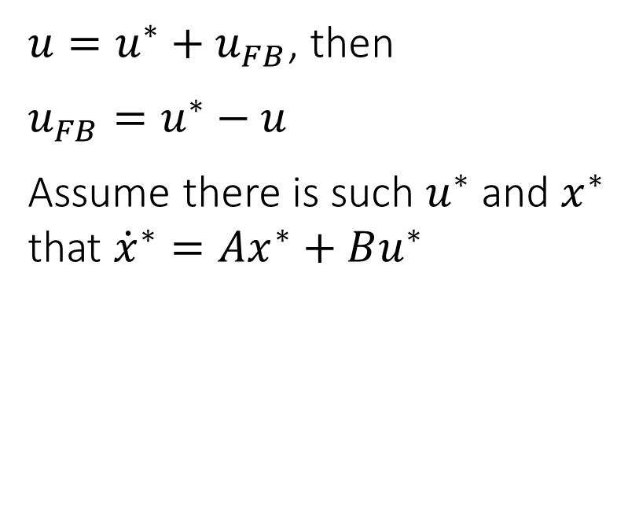
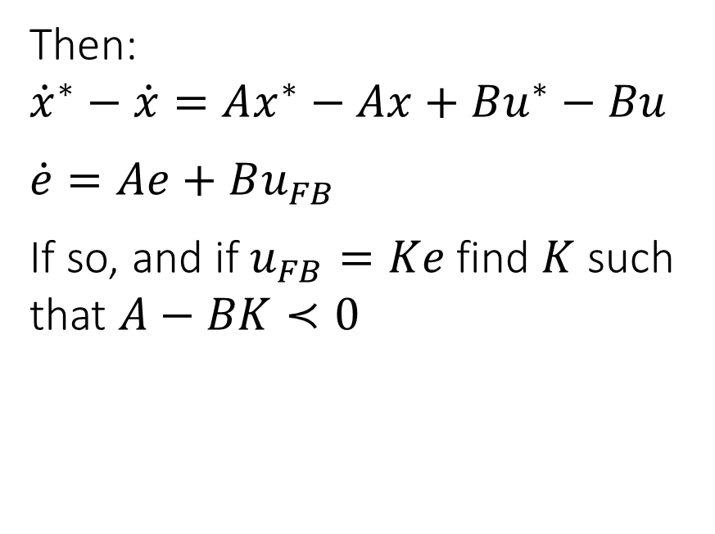
Control Error and Trajectory Tracking (2/2)
$u=u^{∗}+u_{FB}$, then
$$u_{FB}=u^{∗}−u$$
Assume there is such $u^{∗}$ and $x^{∗}$ that ${\dot{x}}^{∗}=Ax^{∗}+Bu^{∗}$
Then:
$${\dot{x}}^{∗}−\dot{x}=Ax^{∗}−Ax+Bu^{∗}−Bu$$
$$\dot{e}=Ae+Bu_{FB}$$
If so, and if $u_{FB}=Ke$ find $K$ such that $A−BK≺0$
Control Theory (Linear Control)
Slide 8

Slide 9
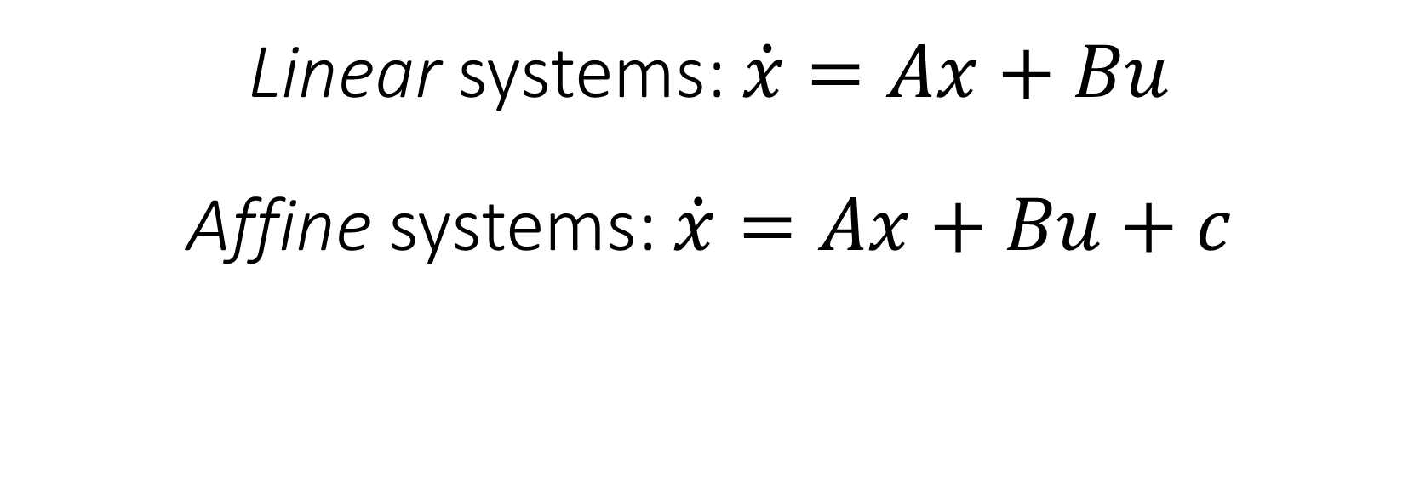
Affine Systems
Linear systems: $\dot{x}=Ax+Bu$
Affine systems: $\dot{x}=Ax+Bu+c$
Control Theory (Linear Control)
Slide 9

Slide 10
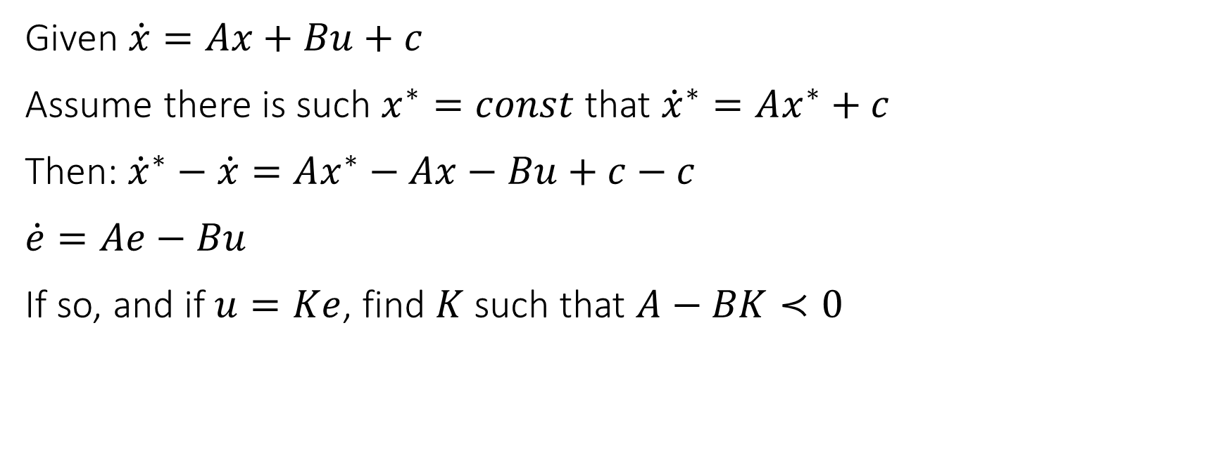
Control Error and Stabilizing Control
Given $\dot{x}=Ax+Bu+c$
Assume there is such $x^{∗}=const$ that ${\dot{x}}^{∗}=Ax^{∗}+c$
Then: ${\dot{x}}^{∗}−\dot{x}=Ax^{∗}−Ax−Bu+c−c$
$$\dot{e}=Ae−Bu$$
If so, and if $u=Ke$, find $K$ such that $A−BK≺0$
Control Theory (Linear Control)
Slide 10

Slide 11
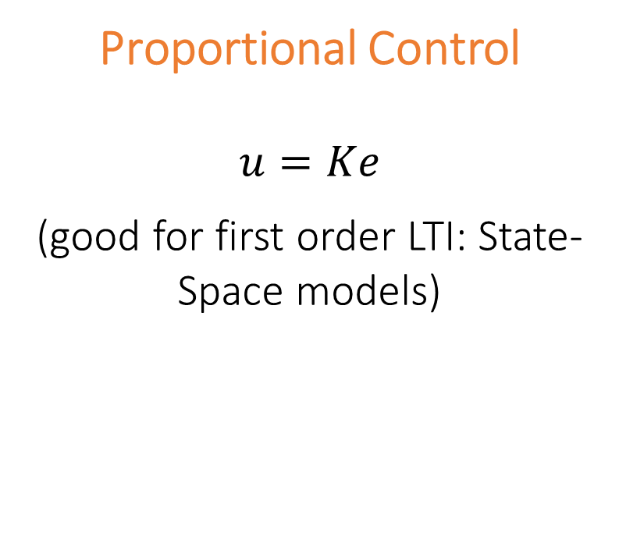
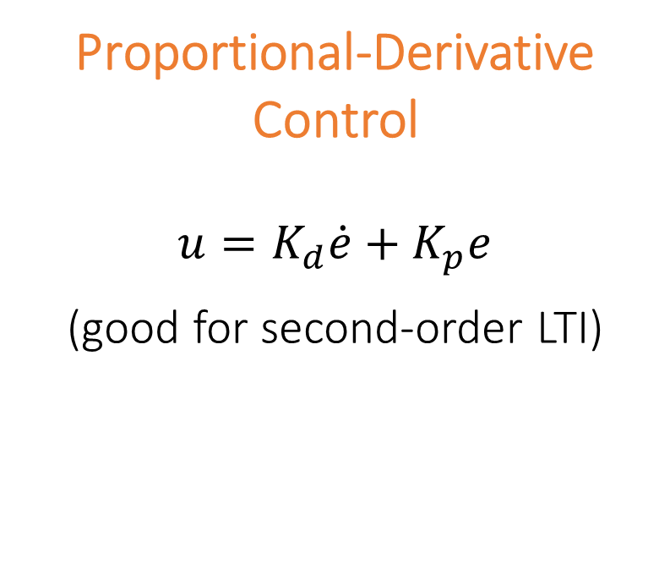
Proportional and Proportional-Derivative Control
Proportional Control
$$u=Ke$$
(good for first order LTI: State-Space models)
Proportional-Derivative Control
$$u=K_{d}\dot{e}+K_{p}e$$
(good for second-order LTI)
Control Theory (Linear Control)
Slide 11

Slide 12
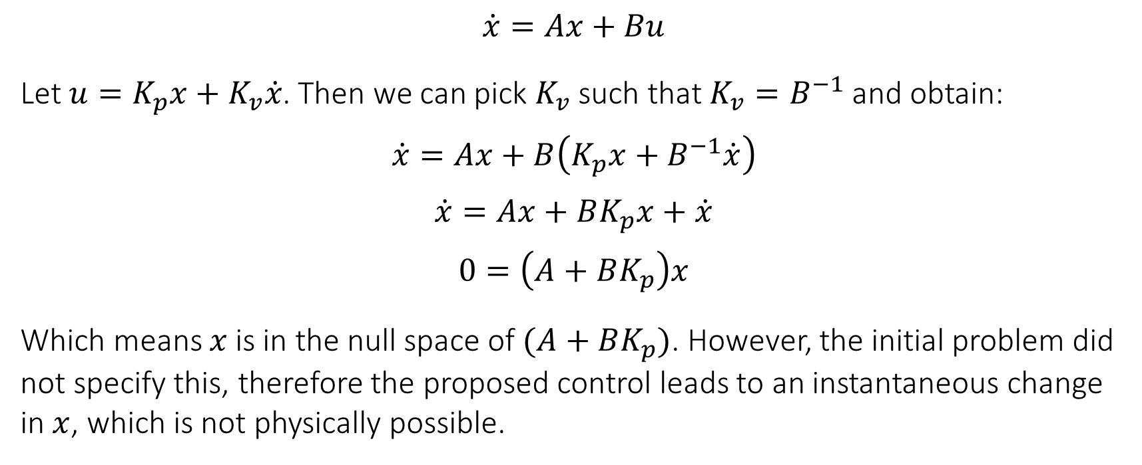
Why you don't want controllers using derivatives of the same order as the equations themselves? (1/2)
$$\dot{x}=Ax+Bu$$
Let $u=K_{p}x+K_{v}\dot{x}$. Then we can pick $K_{v}$ such that $K_{v}=B^{−1}$ and obtain:
$$\dot{x}=Ax+B\left(K_{p}x+B^{−1}\dot{x}\right)$$
$$\dot{x}=Ax+BK_{p}x+\dot{x}$$
$$0=\left(A+BK_{p}\right)x$$
Which means $x$ is in the null space of $(A+BK_{p})$. However, the initial problem did not specify this, therefore the proposed control leads to an instantaneous change in $x$, which is not physically possible.
Control Theory (Linear Control)
Slide 12

Slide 13
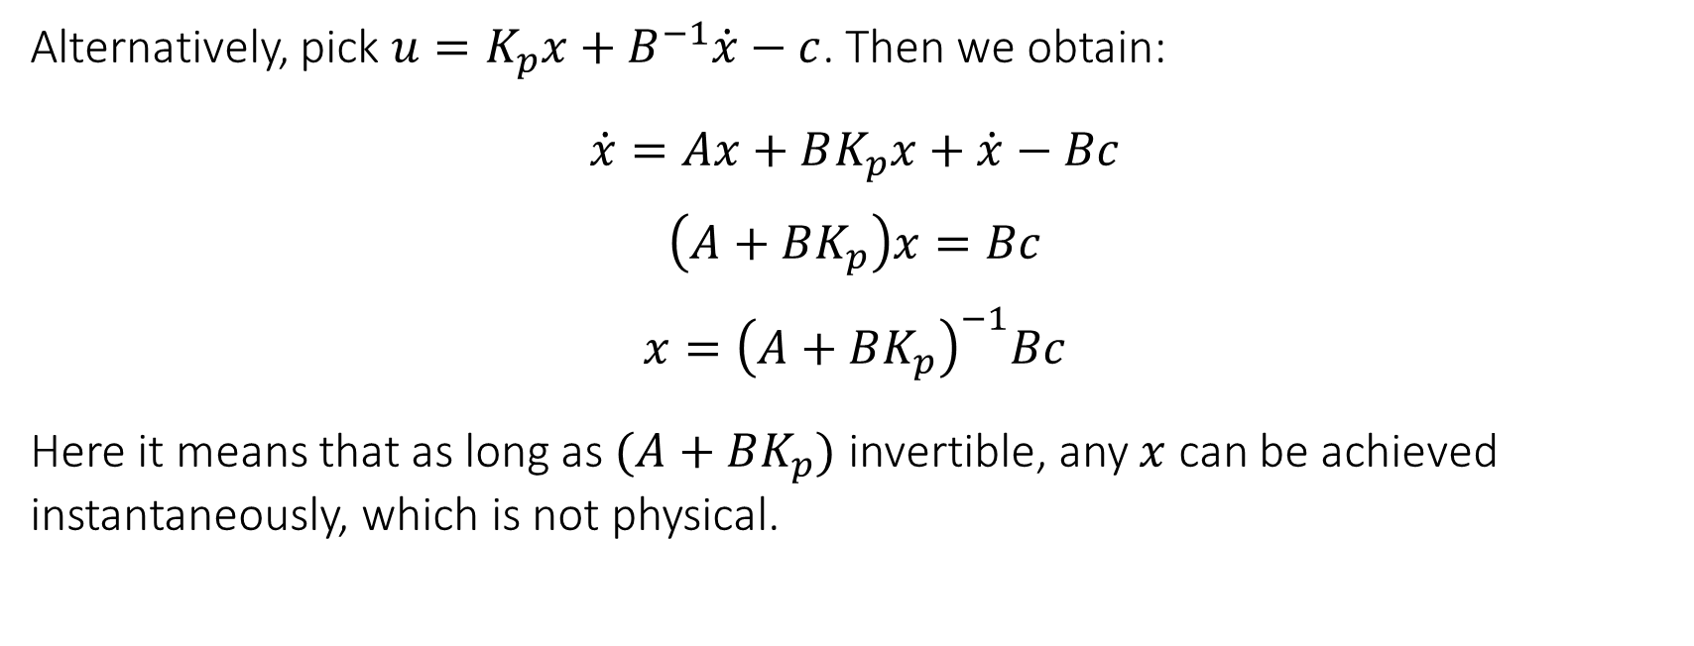
Why you don't want controllers using derivatives of the same order as the equations themselves? (2/2)
Alternatively, pick $u=K_{p}x+B^{−1}\dot{x}−c$. Then we obtain:
$$\dot{x}=Ax+BK_{p}x+\dot{x}−Bc$$
$$\left(A+BK_{p}\right)x=Bc$$
$$x={\left(A+BK_{p}\right)}^{−1}Bc$$
Here it means that as long as $(A+BK_{p})$ invertible, any $x$ can be achieved instantaneously, which is not physical.
Control Theory (Linear Control)
Slide 13

Slide 14
Proportional-Integral-Derivative (PID)
(black board)
Theory:
Practice:
https://www.youtube.com/watch?v=wkfEZmsQqiA
https://www.youtube.com/watch?v=FSAfFw_dqgA
Control Theory (Linear Control)
Slide 14

Slide 15
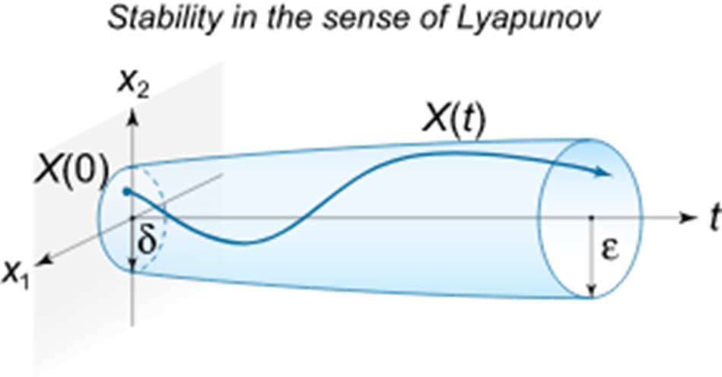
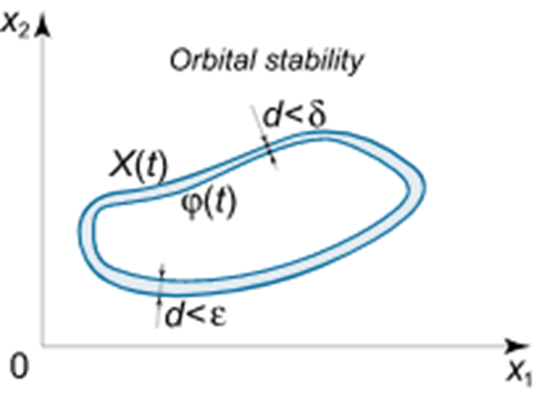
Lyapunov Stability
Control Theory (Linear Control)
Slide 15

Slide 16
The End
Do you have any questions?

